Slide 1
Storyboard:
ACME, LLC

Slide 2

Visuals: | Intro, Introduction and Importance:
Description: | A modern office setting with a friendly and professional narrator standing center stage. The narrator is dressed in business attire. The company logo and the title "Effective Communication for Housing Allowances" appear on the screen.
Scene View: Intro and Logo

Slide 3

Scene 1: | Introduction to the Housing Allowance Amendment training video | Video Illustration
Description: | The video begins with Account Manager, Joe standing in an office with road map to effective communication with the client and teams.
Dialogue: | Welcome to our training on effective communication regarding Housing Allowance Amendments. This 5-minute video, which contains real-world cases from our clients at ACME, will guide you through the best practices for engaging with clients and our operations and tax teams to ensure clear, accurate, and compliant communications.

Slide 4



Scene 2: | Amy realizes there is an issue with an employee’s taxes regarding Housing Allowance. | Video Illustration
Description: | Amy is at her desk, reviewing the discrepancies with her employee’s tax set up for Housing Allowance.
Description: | Amy contacts Joe, ACME Account Manager, for help with the Housing Allowance Amendment, typing an email to Joe about the amendment.
Dialogue: | "Hello, Joe. I hope you’re having a great day. I have an employee, Susan Axel, who needs a retroactive housing allowance added...“

Slide 5
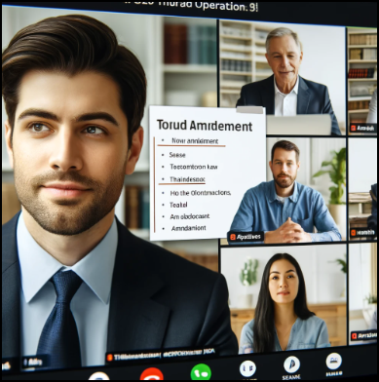
Scene 3: | Team Consultation | Video Illustration
Description: | Joe is in a Zoom meeting with his team, discussing the issue. Three team members, including Joe, are attending. They are looking at a document shared on the Zoom screen and discussing it.
Dialogue: | "Does the church have State Unemployment Insurance (SUI) or is SUI exempt?"

Slide 6

Scene 4: | Joe's Research | Video Illustration
Description: | Joe is sitting at his computer, looking at the "Tax Maintenance" report on the isolved HCM system. The screen displays various tax-related details. Joe is focused on his work, with a pen and notepad beside him on the desk. Provide an example of a real isolved HCM Tax Maintenance print screen.
Dialogue: | (Narrator) "The account manager logs into isolved HCM and pulls the 'Tax Maintenance' report..."

Slide 7
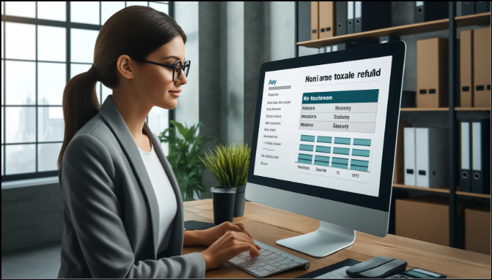
Scene 5: | Amy's Clarification | Video Illustration
Description: | Amy is sitting at her desk again, typing an email on her laptop. She looks focused and thoughtful. The setting remains the same as Scene 1, with her desk, laptop, notepad, and bookshelf in the background.
Dialogue: | "Please confirm that my understanding is correct. On behalf of North Coventry Township..."

Slide 8

Scene 6: | Joe's Explanation | Video Illustration
Description: | Joe is at his desk, typing a detailed email response. The setting is similar to Scene 2, with a close up of Joe typing on his computer.
Dialogue: | The work authorization only covers Q1 because that's what we charge for..."

Slide 9


Scene 7: | Client Agreement | Video Illustration
Description: | Amy is signing the authorization form. She is sitting at her desk, with the form in front of her and a pen in hand. The setting remains the same as previous scenes with Amy, with her desk, laptop, notepad, and the bookshelf in the background.
Dialogue: | "Perfect; thank you for the confirmation and explanation. I will sign the authorization form..."

Slide 10
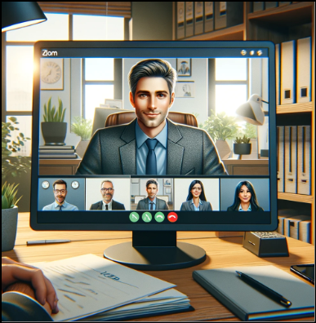
Scene 8: | Internal Update | Video Illustration
Description: | Joe is on a Zoom call with the ACME Operations team. The screen shows a split view with Joe on one side and the team members on the other. Joe is speaking, and the team members are listening attentively. There are notes and details about the amendment on Joe's screen.
Dialogue: | "Perfect; thank you for the confirmation and explanation. I will sign the authorization form..."

Slide 11
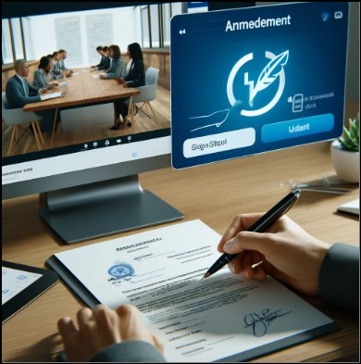

Scene 9: | Internal Process to Sign and Push Work Auth to Tax | Video Illustration
Description: | Joe is at his desk holding the signed document from Amy. Joe then sends the document to tax via Zoom Tax Chat channel.
Dialogue: | "Perfect; thank you for the confirmation and explanation. I will sign the authorization form..."

Slide 12

Scene 10: | Outro ACME Company Logo | Video Illustration
Description: | Video Outro enters the scene. Music volume increases slightly, the logo and outro fade to black and video ends.
Dialogue: | No dialog.

